Slide 1

Chapter 2
Section 2.3
Introduction to File Input
Slides prepared by Rose Williams, Binghamton University
Kenrick Mock, University of Alaska Anchorage

Slide 2
Introduction to File Input/Output
The Scanner class can also be used to read from files on the disk
Here we only present the basic structure of reading from text files
Some keywords are introduced without full explanation
More detail in Chapter 10
By covering the basics here your programs can work with real-world data that would otherwise be too much work to type into your program every time it is run

Slide 3
Text Input
Import the necessary classes in addition to Scanner
import java.io.FileInputStream; import java.io.FileNotFoundException;
Open the file inside a try/catch block
If an error occurs while trying to open the file then execution jumps to the catch block
This is discussed in more detail in Chapter 9
Use nextInt(), nextLine(), etc. to read from the Scanner like reading from the console, except the input comes from the file

Slide 4
Try/Catch Block
Scanner fileIn = null ; // initializes fileIn to empty
try {
// Attempt to open the file
fileIn = new Scanner( new FileInputStream("PathToFile"));
}
catch (FileNotFoundException e) {
// If the file could not be found, this code is executed
// and then the program exits
System.out.println("File not found.");
System.exit(0);
}
... Code continues here

Slide 5
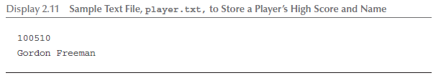
Text File to Read
This file should be stored in the same folder as the Java program in the following display

Slide 6
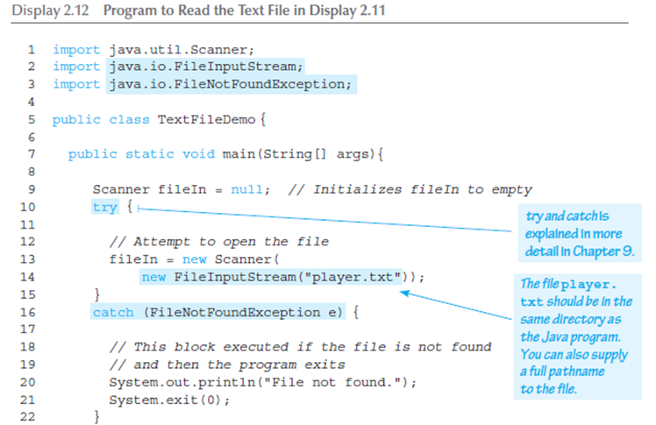
Program to Read a Text File

Slide 7
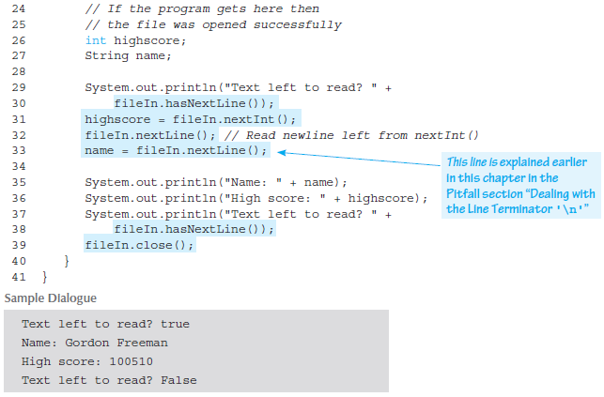
Program to Read a Text File

